Slide 1
Ali Al-Ramini
About me
Data Scientist, Mechanical Engineer, and AI Engineer with 5+ years of experience in research, development, data science, and machine learning in multiple field including transportation, medicine, ed-tech, and insurance.
Education
Ph.D. Mechanical Engineering 2023, UNL
M.S. Architectural Engineering 2020, UNL
B.S. Mechanical Engineering 2018, University of Jordan
Interests: Philosophy, Psychology, Religion, and Politics
Hobbies
Basketball and Chess / I am Lakers, Packers, and Real Madrid fan
Selected Accomplishments (5 Journal Articles)
“Diagnosis of disease affecting gait with a body acceleration-based model using reflected marker data for training and a wearable accelerometer for implementation” Nature Scientific Reports 2023.
“Machine Learning-Based Peripheral Artery Disease Identification Using Laboratory-Based Gait Data” Sensors 2022. Al-Ramini et al.
“Quantifying changes in bicycle volumes using crowdsourced data”. Environment and Planning B: Urban Analytics and City Science 2022. Al-Ramini et al
Part of Nebraska Team that Ranked Top 10 XPRIZE Pandemic Response Global Challenge.

Slide 2
Problem Overview: Fraud Detection Case Study
Objective: Develop a robust model to predict fraudulent transactions.
Challenge: Addressing the imbalance in the dataset where fraudulent transactions are significantly outnumbered by non-fraudulent ones.
Impact: Enhancing the accuracy of fraud detection will directly reduce financial losses and increase trust in transaction processes.

Slide 3
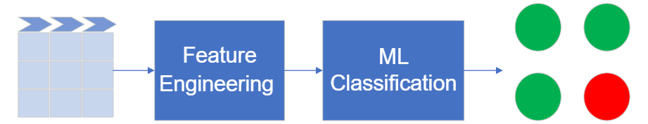
Solution Approach
Programming Language: Python
Initial Steps: Loaded dataset, checked for missing values.
Feature Engineering: Enhanced data features including time conversion, one-hot encoding for categorical variables.
Model Exploration: Evaluated Random Forest, Gradient Boosting, and Logistic Regression using techniques like SMOTE and class weight adjustments for balanced model training.

Slide 4
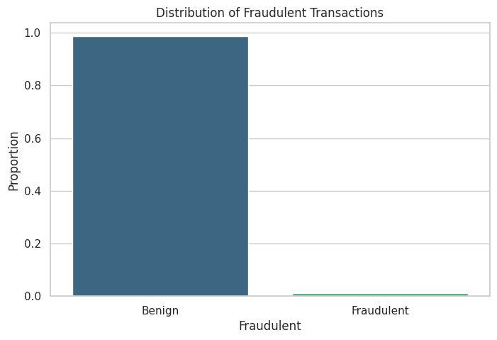
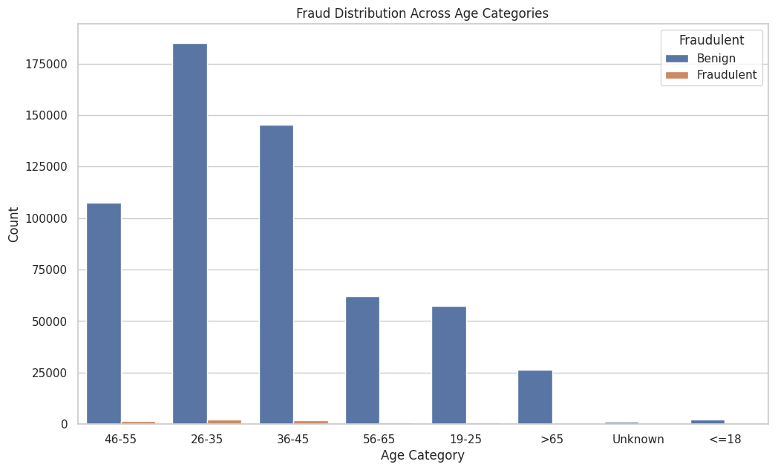
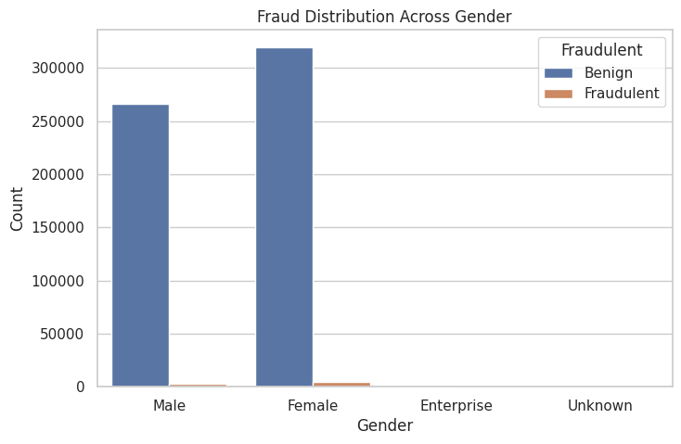
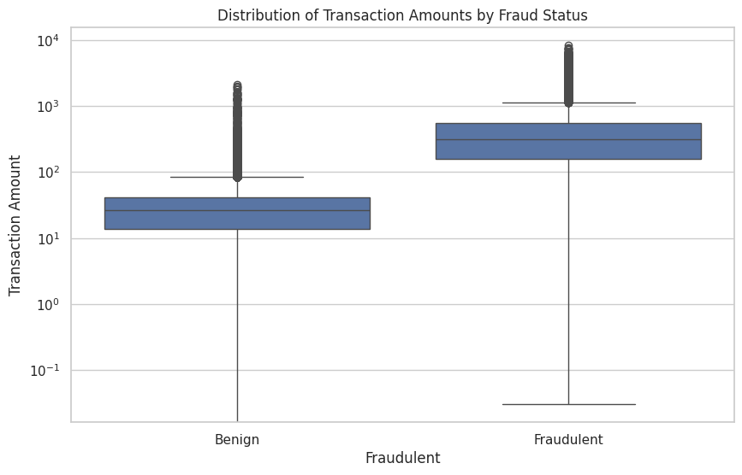
Exploratory Data Analysis
presence of fraud across both male and female categories
Benign: 98.79%
fraud 1.21%
middle age categories (26-45 years) might be more susceptible to fraud
Fraudulent transactions a wider range and higher transaction amounts

Slide 5

Enhancing Data for Predictive Accuracy
Time of Day: Derived from transaction “steps” to capture behavioral patterns by hour.
Scaling Features: Standardized 'Amount' to normalize data scale across features.
Categorical Encoding: Simplified model complexity by grouping rare categories.

Slide 6
Model Selection, Training, and Performance
Model Choices: Focused on models well-suited for classification tasks with imbalanced data.
Methods: Employed direct application, SMOTE, and class weights to find the optimal approach for each model.
Final Selection: Chose Gradient Boosting with Direct Method due to its high performance and balanced metrics (AUC-ROC and MCC)
Model | Precision | Recall | F1-Score | AUC-ROC | MCC | Method
Random Forest | 0.99 | 0.99 | 0.99 | 0.81 | 0.67 | Direct
Gradient Boosting | 0.99 | 0.99 | 0.99 | 0.80 | 0.72 | Direct
Logistic Regression | 0.99 | 0.99 | 0.99 | 0.78 | 0.71 | Direct
Naive Model | 0.98 | 0.99 | 0.98 | 0.50 | 0.00 | Direct
Random Forest | 0.99 | 0.96 | 0.97 | 0.90 | 0.42 | SMOTE
Gradient Boosting | 0.99 | 0.93 | 0.95 | 0.95 | 0.35 | SMOTE
Logistic Regression | 0.99 | 0.92 | 0.95 | 0.95 | 0.34 | SMOTE
Naive Model | 0.98 | 0.99 | 0.98 | 0.50 | 0.00 | SMOTE
Random Forest | 0.99 | 0.99 | 0.99 | 0.80 | 0.67 | Weights
Gradient Boosting | 0.99 | 0.99 | 0.99 | 0.80 | 0.72 | Weights
Logistic Regression | 0.99 | 0.99 | 0.99 | 0.89 | 0.58 | Weights
Naive Model | 0.98 | 0.99 | 0.98 | 0.50 | 0.00 | Weights

Slide 7
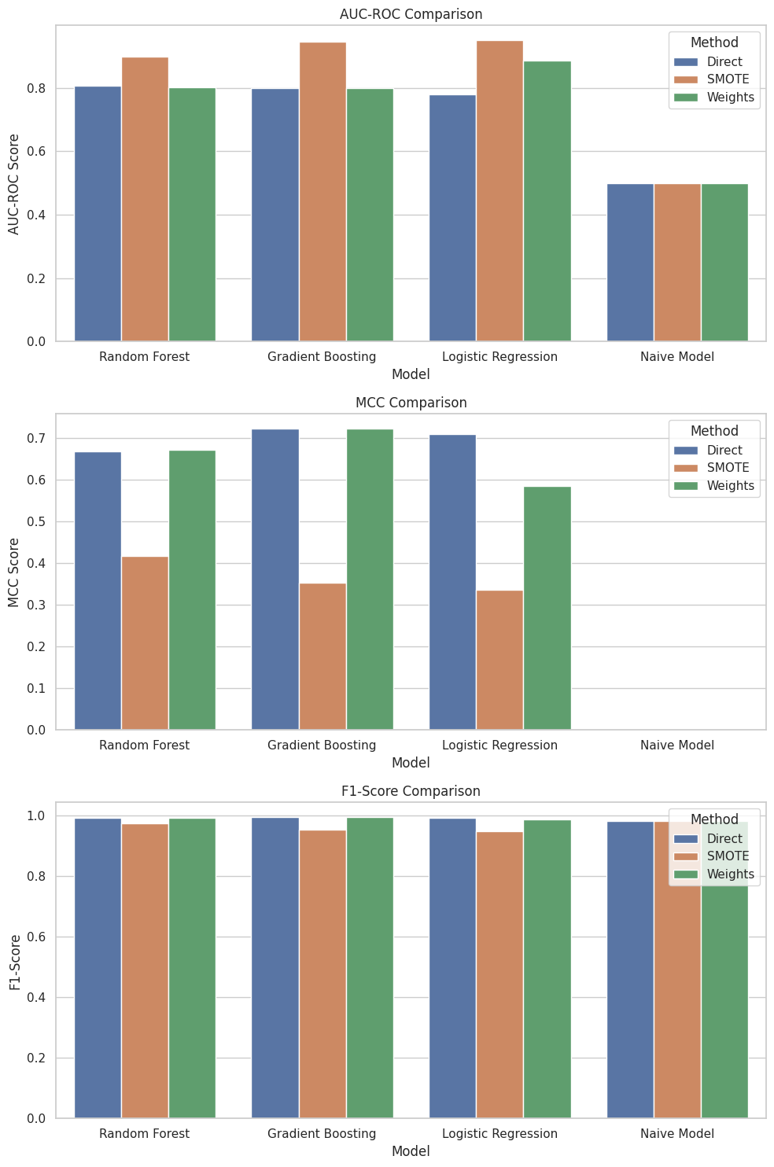
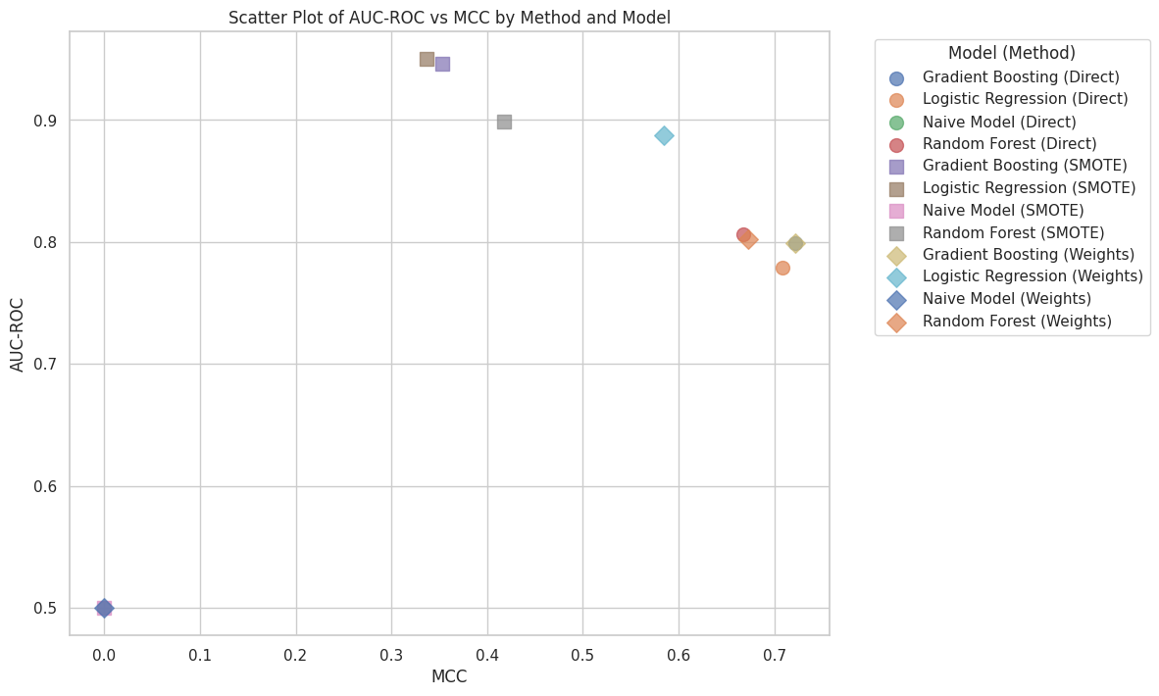
Comparative Analysis of Model Outcomes

Slide 8
Final Submission Product
Deployed a Flask-based API on Heroku for real-time fraud detection predictions.
The project code and documentation are maintained in a Git repository for accessibility and further development.
The operational model allows for scalable, efficient, and accurate fraud detection, contributing to safer financial transactions.
https://github.com/aliramini2/deloitte_interview_ali

